Slide 1

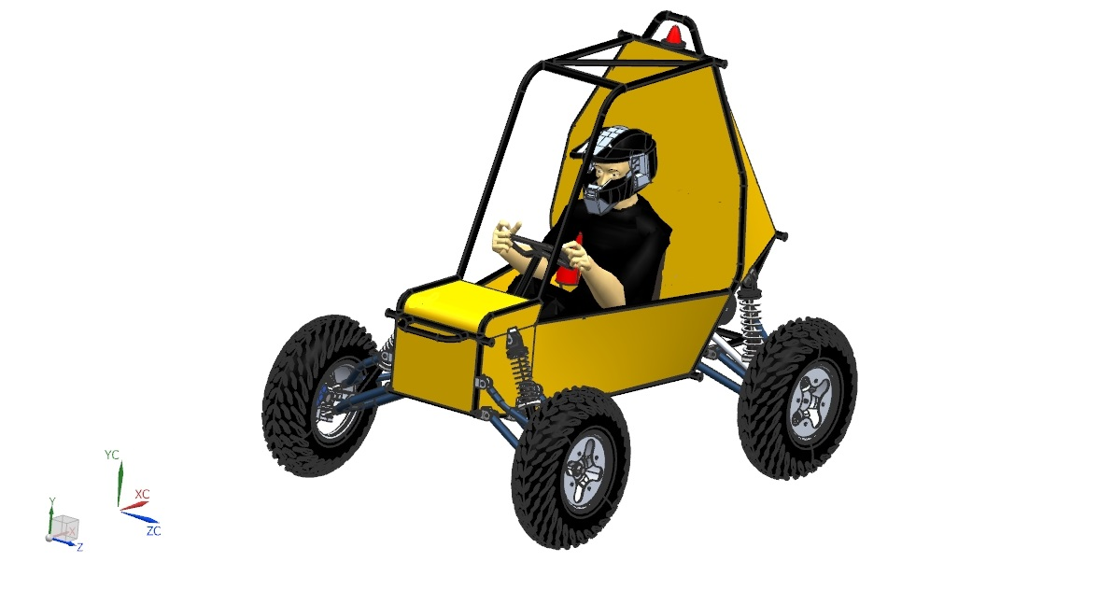
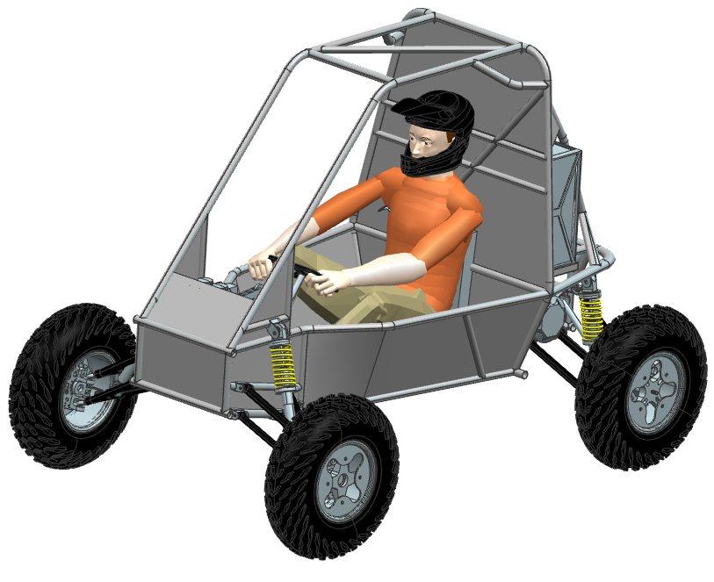





VIRTUAL
PRESENTATION
eBAJA
2019
TEAM ID: 20092
2019 - 2020
2018 - 2019
Previous Team ID | : | 19047
Car Number | : | E-148
Overall Score | : | 249.5
TEAM SOVEREIGN
Awards | : | 0
OUR SPONSORS:

Slide 2
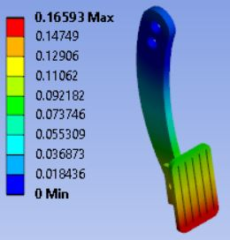
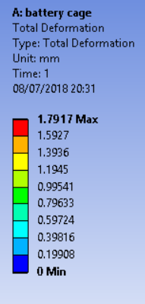
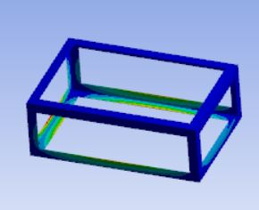
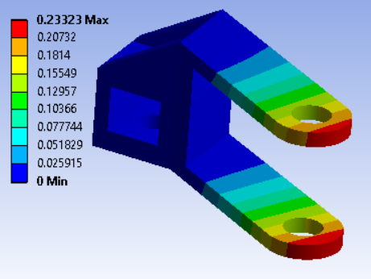
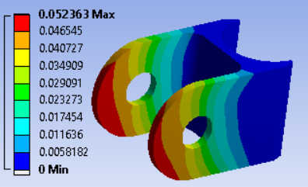
2 A: LESSONS LEARNT
ROLL CAGE & AGGREGATES
ASPECTS | LESSONS LEARNT | IMPROVEMENTS
Strut | Buckling in the spring due to manufacturing practice error | Designed springs with appropriate allowances & accurate calculations
Steering link | Steering link was bent due to unaccounted forces | Performed analysis undertaking all considerable forces
Kill switch | One kill switch was damaged due to circulating current | Power diode circuit is designed this time to prevent damage
Brake Pedal | Spongy pedal due to air bubbles in hydraulic Systems | Proper mounting of master cylinder
Frame (Rollcage) | Bends have low strength comparing to welds at critical points | Replacing critical bends with welded joints to maintain strength
Motor Mounting | Possibility of contact with obstacles on uneven tracks | Elevated motor mounting points
Harness | Higher Complexity of circuit diagram was present | Proper colour coding, number tags and connectors will be present
VEHICLE PERFORMANCE
MAIN EVENTS | LESSONS LEARNT | IMPROVEMENTS
Brake Test | Difficulty in simultaneous locking of four wheels | Double flaring to avoid leakage.
Endurance | Wobbling of rear tires | Two hinge points at rear knuckle.
Endurance | Displayed inaccurate vehicle parameters | Implementation of CAN Bus

Slide 3
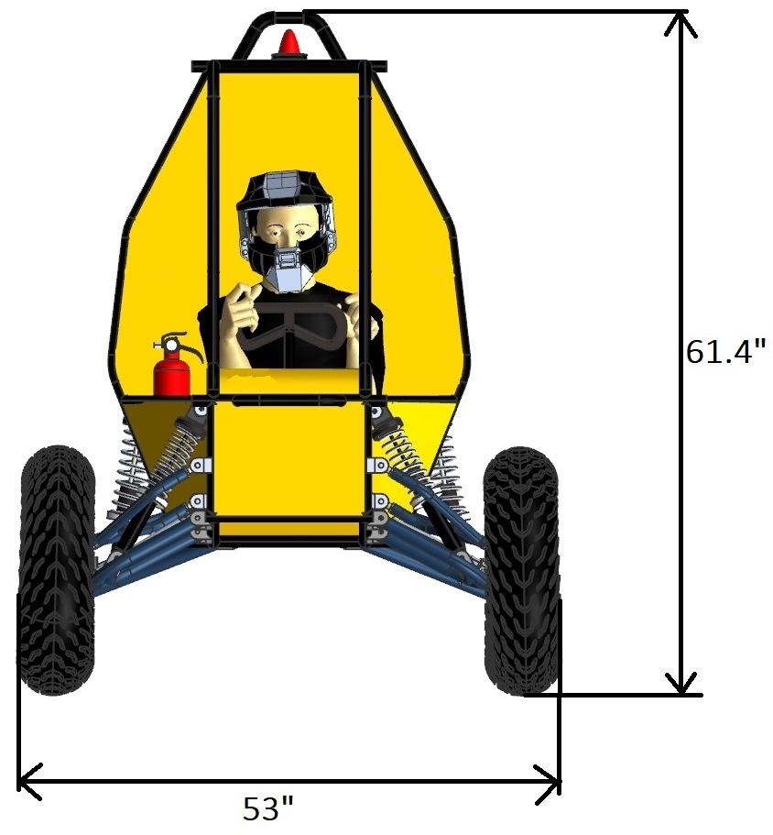
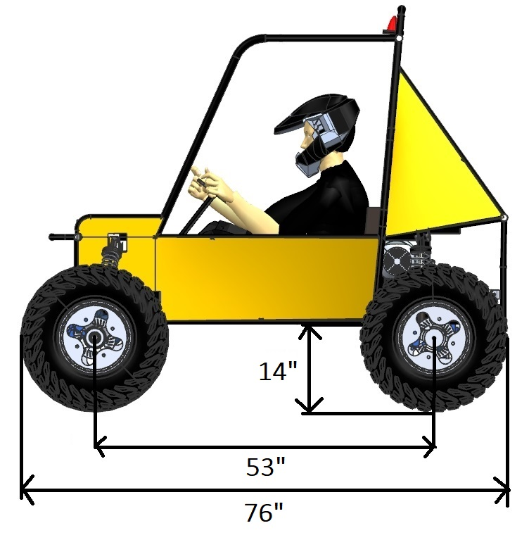
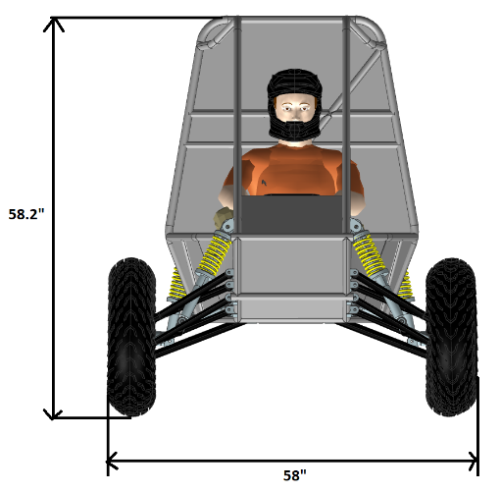
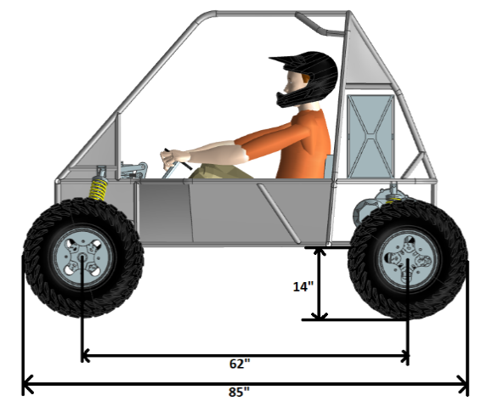
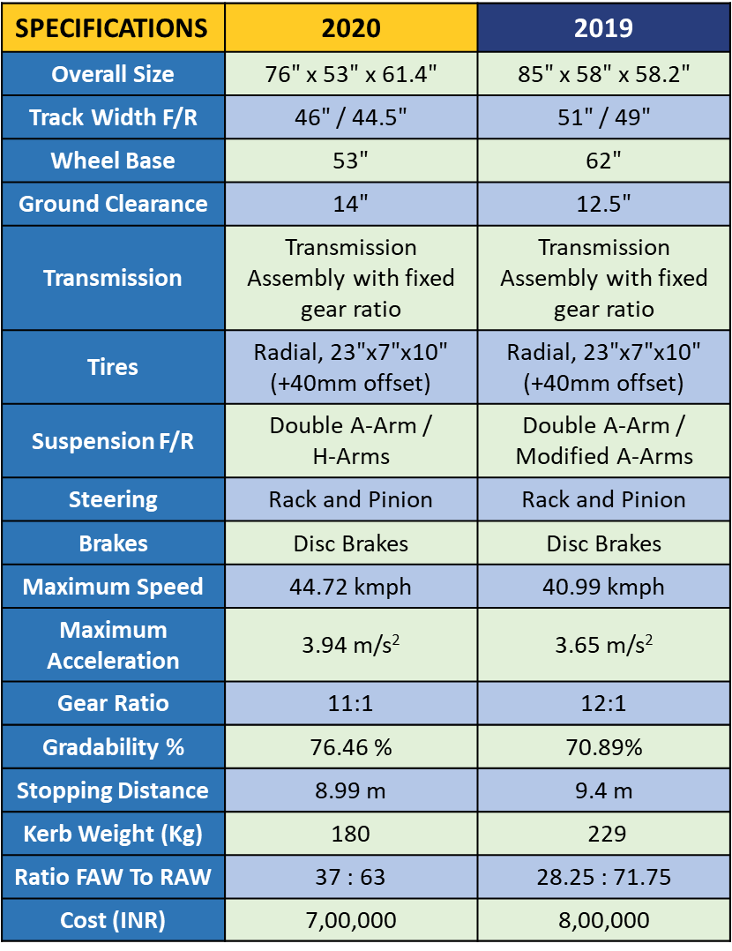
2 B: GENERAL SPECIFICATION - COMPARISON
SPECIFICATIONS | 2020 | 2019
Overall Size | 76$"$ x 53$"$ x 61.4$"$ | 85$"$ x 58$"$ x 58.2$"$
Track Width F/R | 46$"$ / 44.5$"$ | 51$"$ / 49$"$
Wheel Base | 53$"$ | 62$"$
Ground Clearance | 14$"$ | 12.5$"$
Transmission | Transmission Assembly with fixed gear ratio | Transmission Assembly with fixed gear ratio
Tires | Radial, 23$"$x7$"$x10$"$ (+40mm offset) | Radial, 23$"$x7$"$x10$"$ (+40mm offset)
Suspension F/R | Double A-Arm / H-Arms | Double A-Arm / Modified A-Arms
Steering | Rack and Pinion | Rack and Pinion
Brakes | Disc Brakes | Disc Brakes
Maximum Speed | 44.72 kmph | 40.99 kmph
Maximum Acceleration | 3.94 m/s² | 3.65 m/s²
Gear Ratio | 11:1 | 12:1
Gradability % | 76.46 % | 70.89%
Stopping Distance | 8.99 m | 9.4 m
Kerb Weight (Kg) | 180 | 229
Ratio FAW To RAW | 37 : 63 | 28.25 : 71.75
Cost (INR) | 7,00,000 | 8,00,000
2020
2019

Slide 4
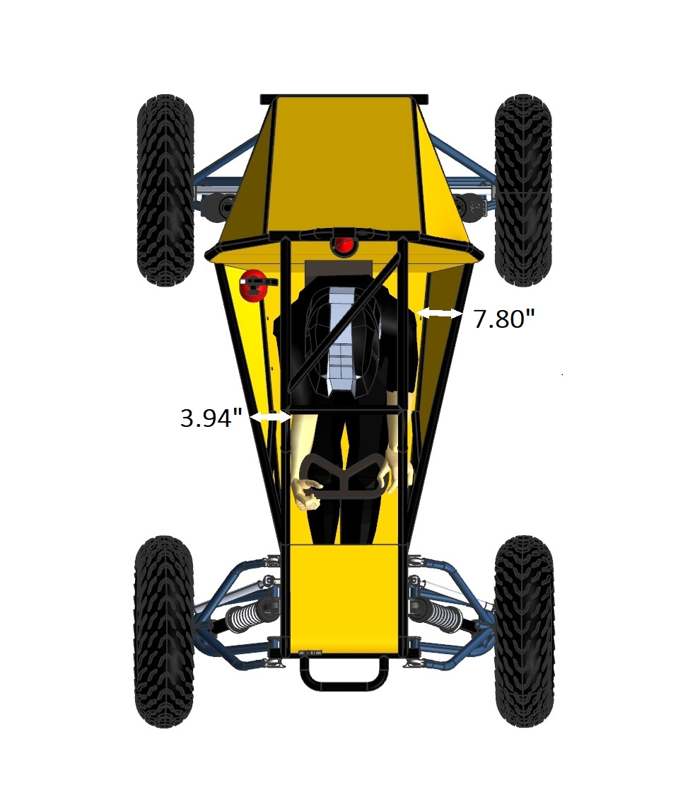
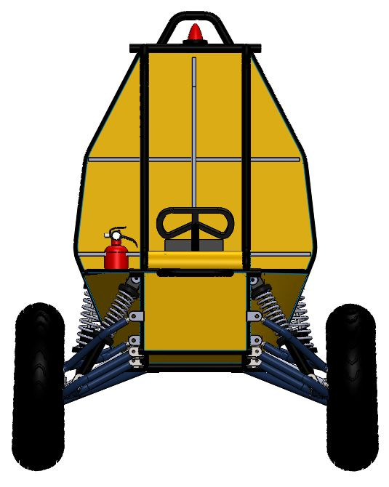
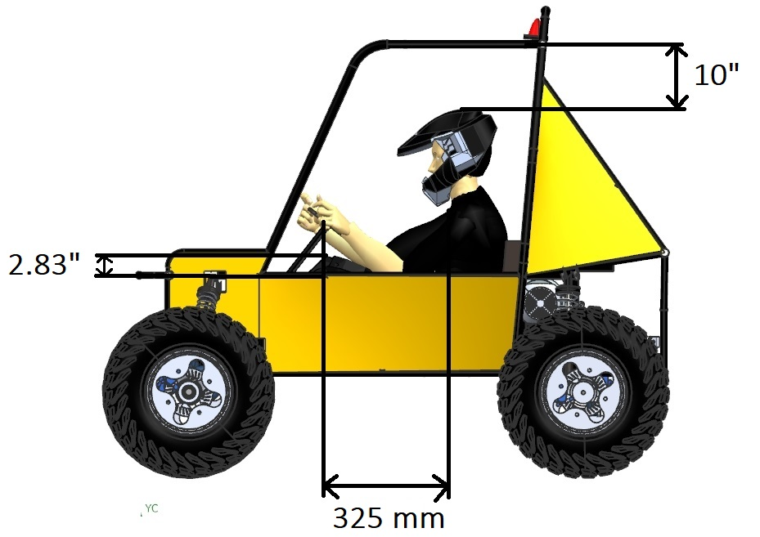
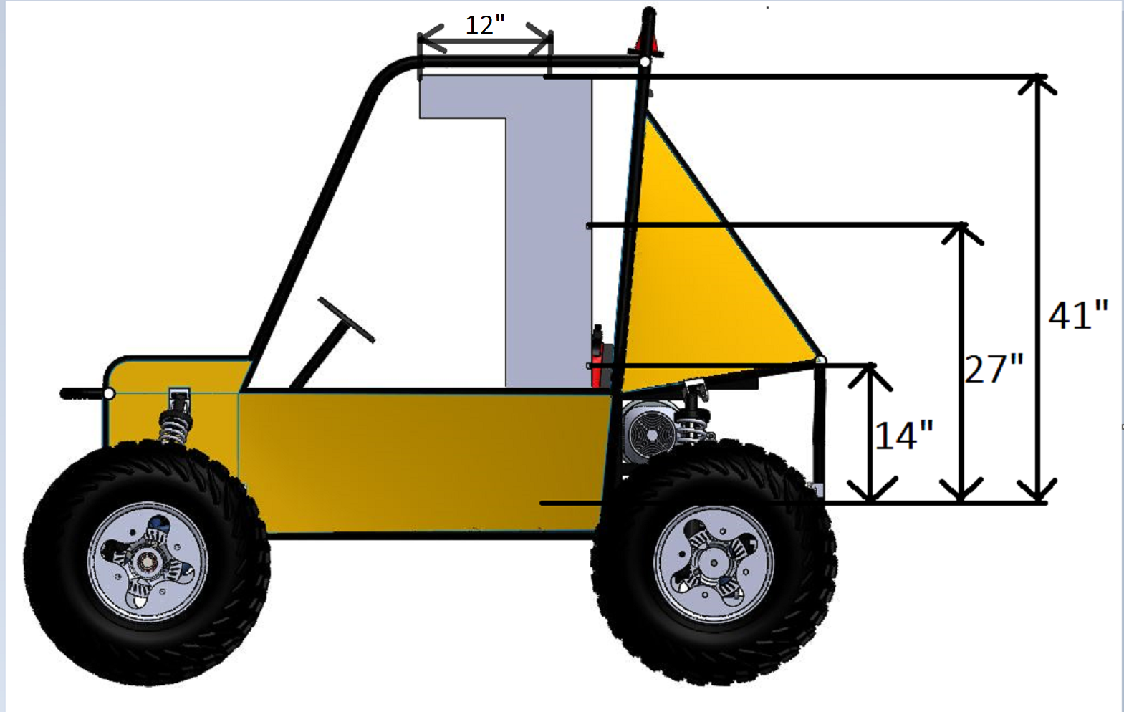
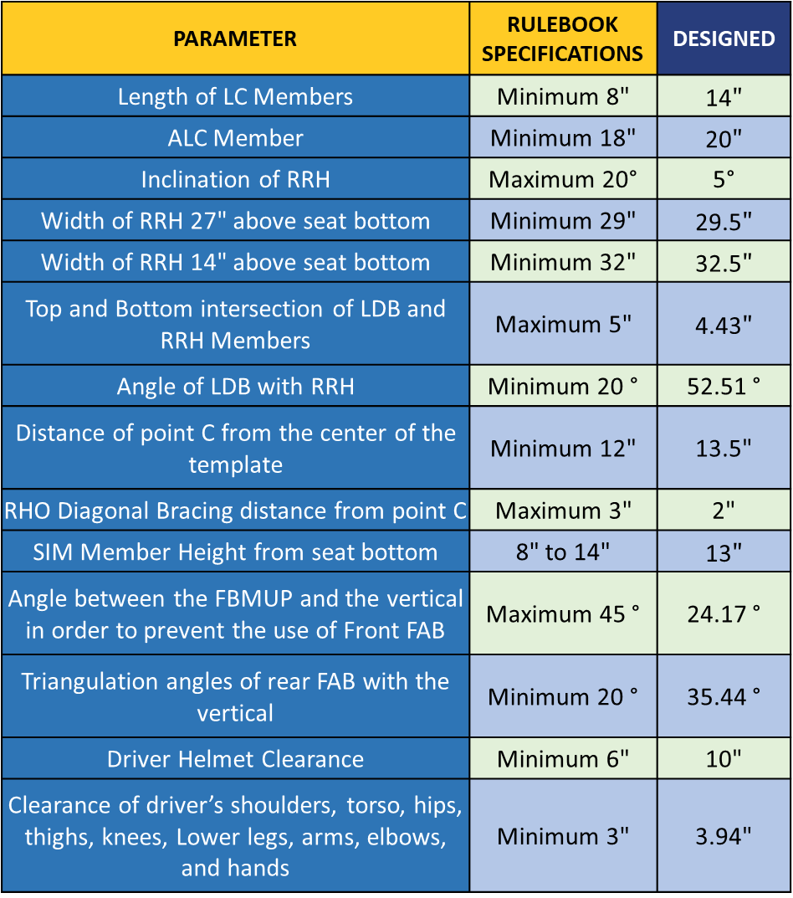
3: ROLL CAGE DESIGN PROCESS-ERGONOMICS
PARAMETER | RULEBOOK SPECIFICATIONS | DESIGNED
Length of LC Members | Minimum 8" | 14$"$
ALC Member | Minimum 18" | 20$"$
Inclination of RRH | Maximum 20° | 5°
Width of RRH 27" above seat bottom | Minimum 29" | 29.5$"$
Width of RRH 14" above seat bottom | Minimum 32" | 32.5$"$
Top and Bottom intersection of LDB and RRH Members | Maximum 5" | 4.43$"$
Angle of LDB with RRH | Minimum 20 ° | 52.51 °
Distance of point C from the center of the template | Minimum 12" | 13.5"
RHO Diagonal Bracing distance from point C | Maximum 3" | 2"
SIM Member Height from seat bottom | 8" to 14" | 13$"$
Angle between the FBMUP and the vertical in order to prevent the use of Front FAB | Maximum 45 ° | 24.17 °
Triangulation angles of rear FAB with the vertical | Minimum 20 ° | 35.44 °
Driver Helmet Clearance | Minimum 6" | 10"
Clearance of driver’s shoulders, torso, hips, thighs, knees, Lower legs, arms, elbows, and hands | Minimum 3" | 3.94"

Slide 5
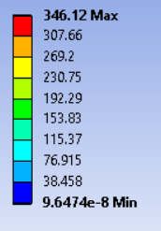
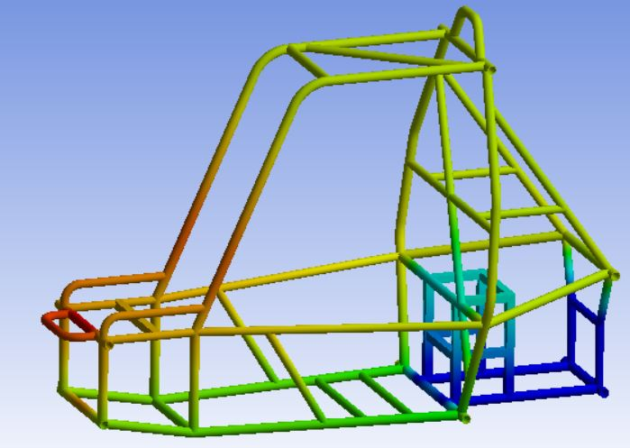
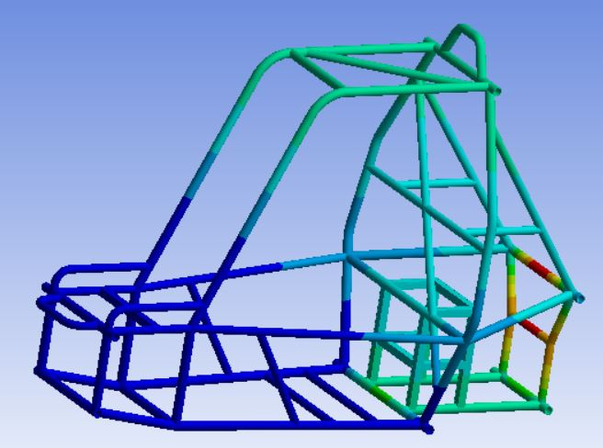
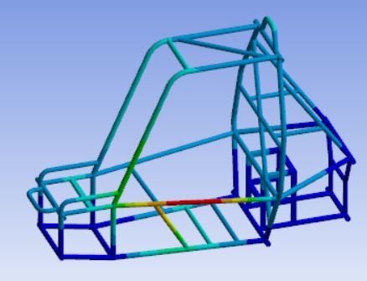
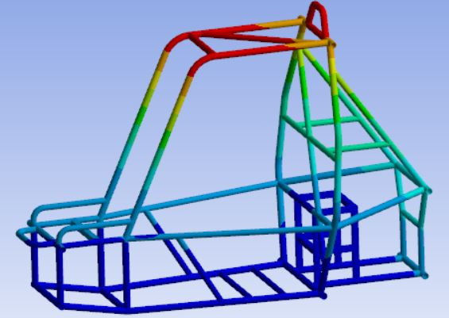

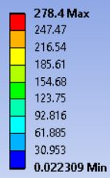
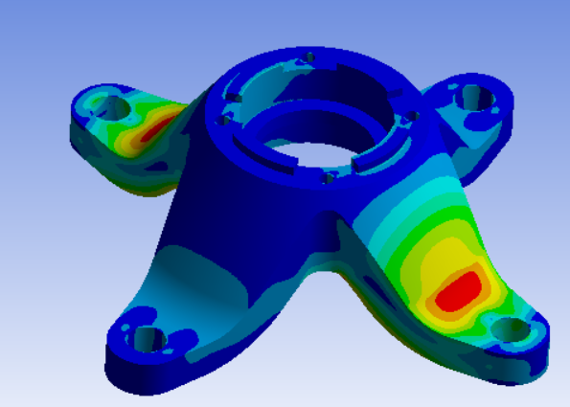
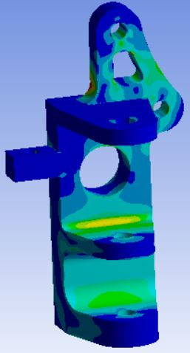
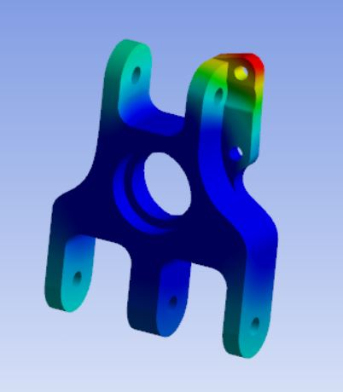
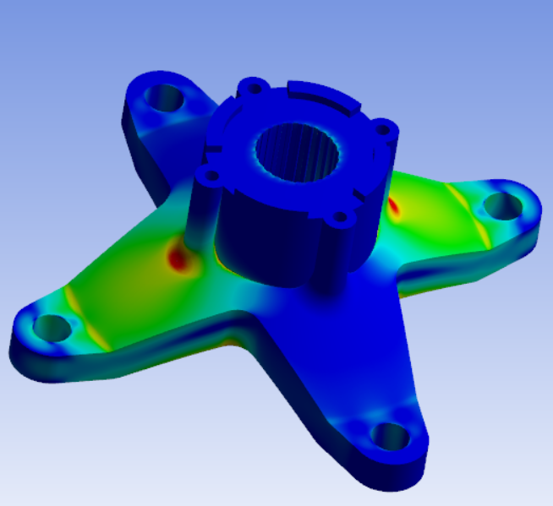
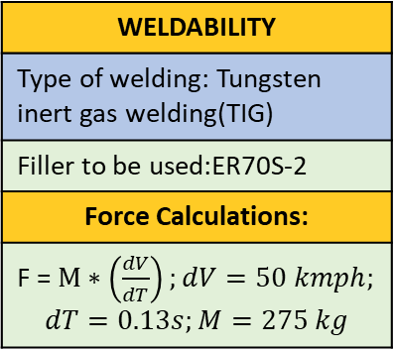
4: CAE
S.No. | Type of Analysis | Total Load Applied | Maximum Equivalent Stress (Von Mises)
1 | Front Impact | 13,100 N (4.85 G) | 193.28 Mpa
2 | Rear Impact | 13,100 N (4.85 G) | 177.07 Mpa
3 | Side Impact | 13,100 N (4.85 G) | 165.24 Mpa
4 | Roll Over | 13,100 N (4.85 G) | 346.12 Mpa
WELDABILITY
Type of welding: Tungsten inert gas welding(TIG)
Filler to be used:ER70S-2
Force Calculations:
F = $M∗\left(\frac{dV}{dT}\right);dV=50 kmph;$ $$dT=0.13s;M=275 kg$$
CAE Details | Solver used : ANSYS | 3D Mesh in Solid Components
1
2
3
4
Max. Deformation | FOS
0.64844 mm | 2.462
Max. Deformation | FOS
0.5567 mm | 2.688
Max. Deformation | FOS
1.5137 mm | 2.88
Max. Deformation | FOS
2.2308 mm | 1.37
Max. Deformation Knuckle
F: 0.41254 mm
R: 0.07325 mm
FOS:
F: 1.806
R: 2.04
Max. Deformation | FOS
0.71718 mm | 1.98
Max. Deformation | FOS
0.20192 mm | 2.13

Slide 6
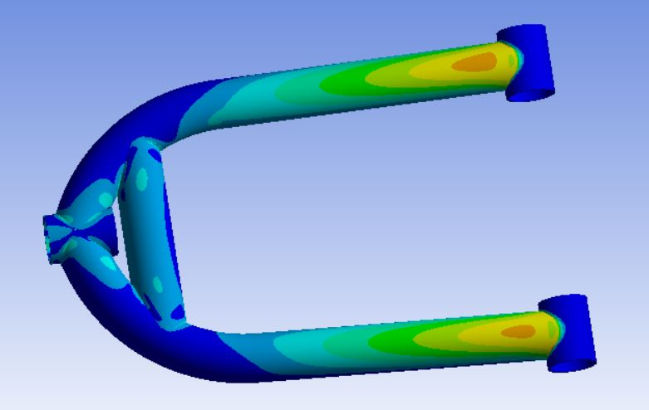
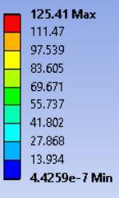
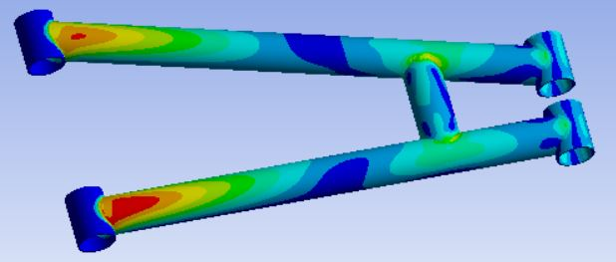
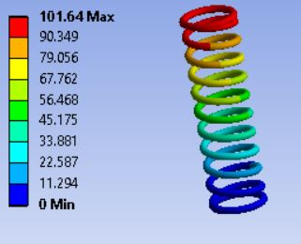
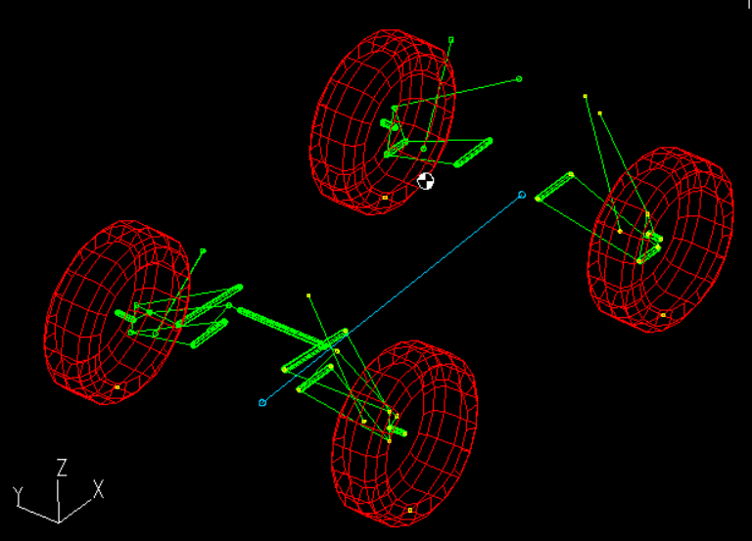
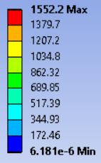
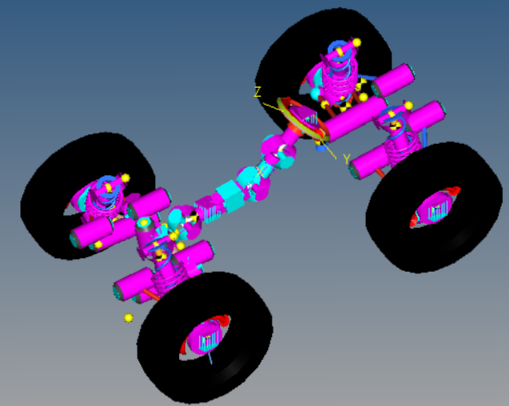
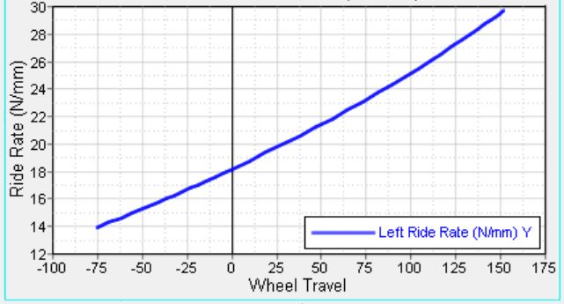
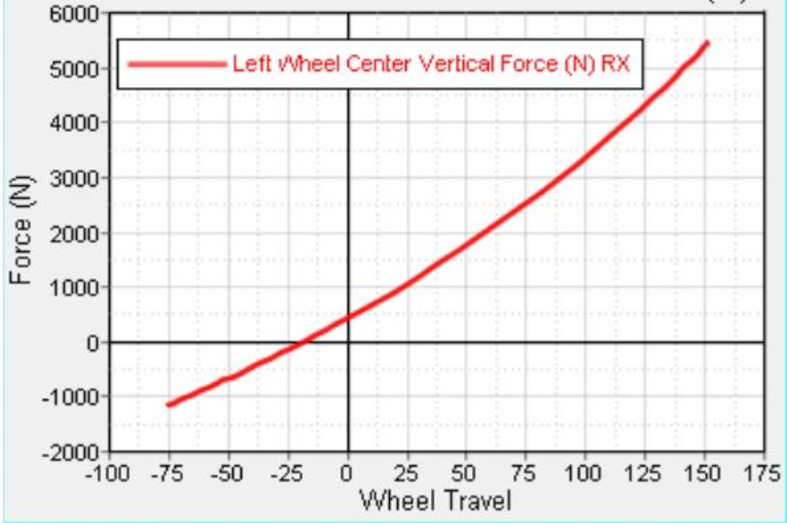
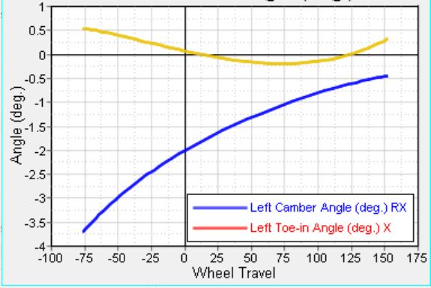
5: SUSPENSION
SPECIFICATIONS | 2020 |  | 2019
 | FRONT | REAR | FRONT | REAR
Suspension | Double A-arms | H-arms | Double A-arms | Modified A-arms
Mass Distribution | 92.5 | 157.5 | 84.73 | 215.26
Sprung Mass | 185 Kg |  | 230 kg
Un-sprung Mass | 65 kg |  | 70 kg
Camber | -2° | 0 | -2° | 0
Caster | 11.26° | 0 | 12° | 0
KPI | 6.64° | 0 | 8.95° | 0
Motion Ratio | 0.6 | 0.65 | 0.65 | 0.77
Roll Centre | 6.95” | 7.24” | 9.52” | 7.8”
Scrub Radius (mm) | 41.17 | - | 32.23 | -
Suspension Travel | Jounce = 6” Rebound = 3” |  | Jounce = 6” Rebound = 2”
Spring Stiffness(N/mm) | 22 | 30 | Progressive
Ride Rate (N/mm) | 17.68 | 22.73 | 6.54 | 24.80
CG Height | 21” |  | 24”
Desired Natural Frequency (Hz) | 1.55 | 1.76 | 2.6 | 3.12
Damping Ratio | 0.7 | 0.7 | 0.7 | 0.7
Damping Stroke (mm) | 90 | 102 | 114.3 | 114.3
Damping Value@0.3m/s | 43.18 | 65.80 | 43.65 | 72.71
IMPROVEMENTS
1. Customized spring design.
2. Dynamic analysis in hypermesh.

Slide 7
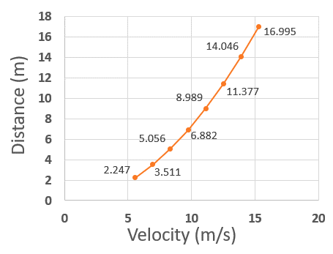
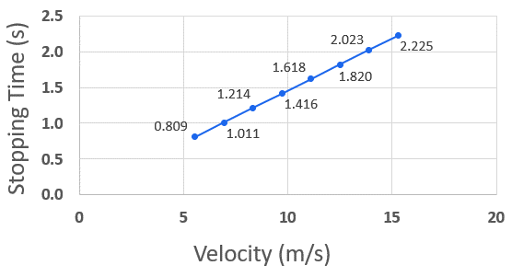
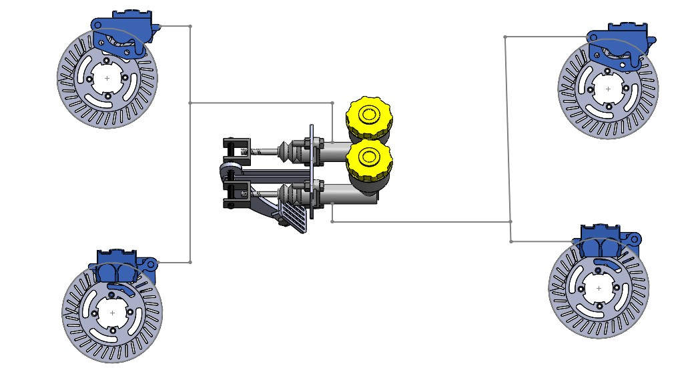
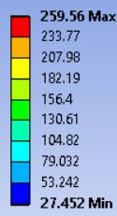
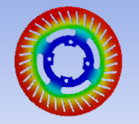
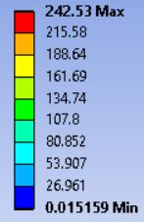
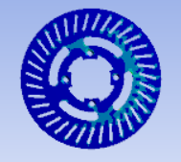
6: BRAKES
SPECIFICATIONS | 2020 | 2019
Pedal Force | 400 N | 400 N
Pedal Ratio | 8:1 | 6:1
Master Cylinder (Bore Size X Stroke) | 19.05 x 25 mm | 17.05 x 25 mm
Brake Caliper Cylinder (Bore Size X Nos.) | 31.75 x 2 mm | 31.75 x 2 mm
Caliper Piston Area | 791.73 mm² | 791.73 mm²
Caliper Pad Area | 1372.81 mm² | 320.7 mm²
Brake Pad Friction Coeff. | 0.45 | 0.45
Brake Fluid | DOT 3 | DOT 3
Effective Radius | 0.075 m | 0.05287 m
Torque Front Required | 244.653 Nm | 334.9 Nm
Torque Rear Required | 149.352 Nm | 172.47 Nm
Torque Front Available | 335.306 Nm | 398.24 Nm
Torque Rear Available | 204.693 Nm | 214.44 Nm
Stopping Distance | 8.99 m | 9.44 m
Force Required By Calipers (Front) | 837.568 N | 1249.245 N
Force Required By Calipers (Rear) | 511.306 N | 658.913 N
Dynamic Load Transfer | 771.44 N | 783.92 N
Static Roll Radius (Tyre) | 11.5’’ | 11.5’’
Pedal Travel | 200 mm | 150 mm
Velocity v/s Stopping Distance
Velocity v/s Stopping time
Front Rear Split Brake System
Thermal Analysis
Stress Analysis

Slide 8
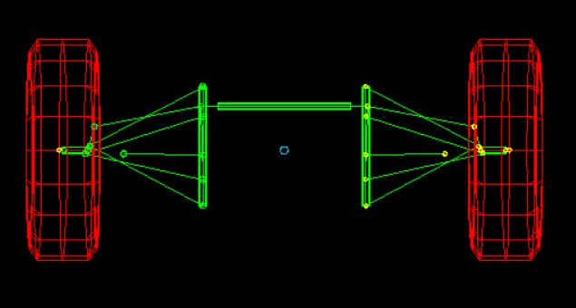
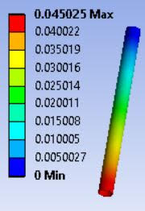
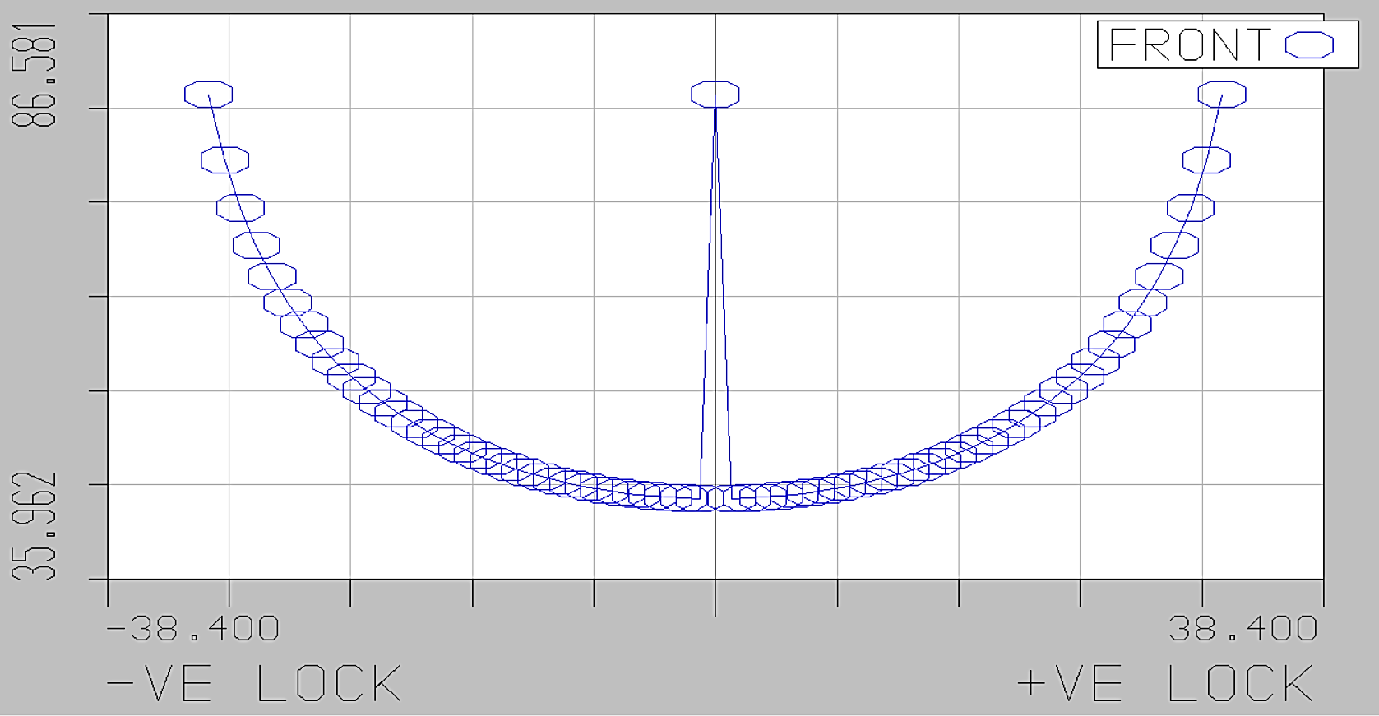
7: STEERING
SPECIFICATION | 2020 | 2019
Steering System | Over steer | Over steer
Steering Geometry | Ackerman 79% | Ackerman 63%
Inner/Outer Angle | 48.66/27.7 (deg) | 49.47/38.61 (deg)
Turning Radius | 1.7 m | 1.468 m
Steering Gear | Rack and pinion | Rack and pinion
Drive Type | CHD | CHD
End To End Travel | 64 mm | 76 mm
Turns Lock To Lock | 1.3 turns | 1.3 turns
Steering Ratio | 49.23 mm/rev | 59.37 mm/rev
IBJ/OBJ Centre Distance | 220.0/501.55 mm | 235.2/569.45 mm
Tie Rod Length | 12.1 in | 14.5 in
Rack Length | 17.323 in | 17 in
Column Type | Single Column | Single Column
Power Assist | - | -
Steering Wheel Diameter | 250 mm | 250 mm
Steering Wheel Torque | 2.4 – 4.1 Nm | 2.8 – 5.9 Nm
Tierod Analysis
Wheel Angle V/s Rack Travel
IMPROVEMENTS
Improvement in Ackerman percentage to reduce slip angle.
Reduction in steering effort by optimizing geometry and reduction weight.
Ackerman Percent V/s Rack Travel

Slide 9
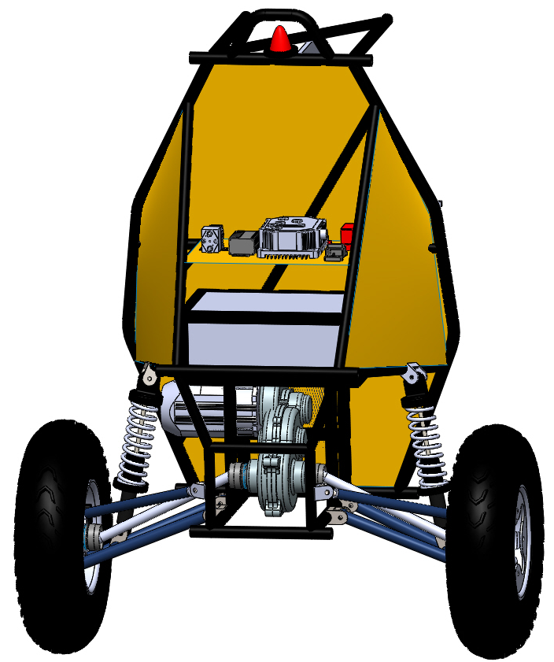
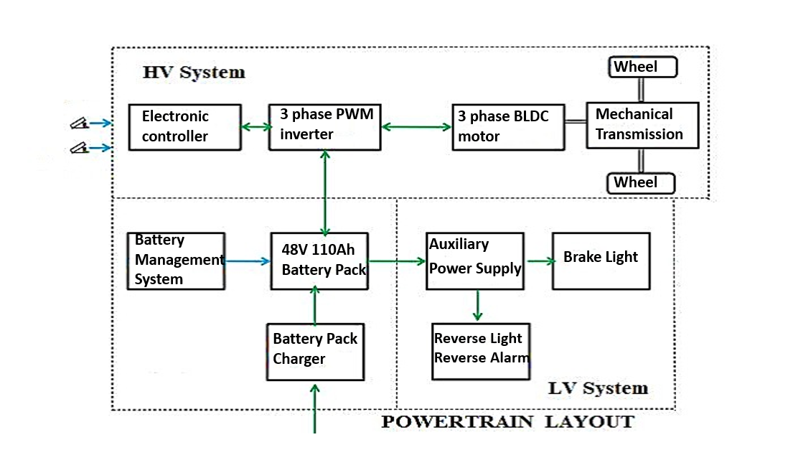

8: POWERTRAIN
MOTOR SPECIFICATIONS |  | TYRE SPECIFICATIONS
BLDC MOTOR (48 V) |  | Outer Diameter | 23”
Max. Torque | 38 Nm | Inner Diameter | 10”
Max. Power | 4.5 kW | Thickness | 7”
INTEGRATION
MOTOR CONTROLLER |  | TRANSMISSION
Voltage | 48 V | Fixed Gear Ratio | 11:1
Speed Control | PWM | Dimension | 16$"$ x 8$"$ x 4$"$
Weight | 2 kg | Weight | 8 kg
BATTERY (Li-ion) |  | NVH CONSIDERATIONS
Cell Voltage | 3.7 V (Nominal) | Sealing actions will be taken to reduce airborne noise in motor and controller Neoprene pads are fitted outside the casing of HV Components. Motor controller is placed at a position of low noise sensitivity. Ensuring Additional inertias in the driveline have room, without torsional nodes
Capacity | 110 Ah (13x42 cells)
Dimension | 17.7$"$ x 11.4$"$ x 7.1$"$
PERFORMANCE
Max Acceleration | 3.942 m/s²
Gradeability | 76.46 %
POWERTRAIN LAYOUT
POWERTRAIN LAYOUT

Slide 10
9: COST AND WEIGHT ANALYSIS
PARTS | ASSEMBLY UNITS | ESTIMATED WEIGHT (kg) |  | TOTAL ESTIMATED COST (INR)
 |  | 2020 | 2019 | 2020 | 2019
Motor | Motor + Controller + Gearbox Assembly | 24 | 27 | 1,35,000 | 1,17,000
Battery & BMS | Li-ion Battery + BMS + Charger | 35 | 68 | 1,35,000 | 3,00,000
Steering | Rack and Pinion + Tie-rods | 2 | 2 | 15,000 | 14,000
Brakes | Master Cylinder + Brake Lines + Calipers + Reservoirs | 8 | 8 | 15,000 | 15,000
Raw Materials | Metal sheet + Roll Cage + Paneling | 37 | 45 | 80,000 | 80,000
Suspension | Spring dampers + Wishbones | 12 | 12 | 85,000 | 60,000
Safety | Goggles + Fire Extinguisher + Tear offs + Seat belt + Driver suit | 5 | 5 | 10,000 | 10,000
Ancillaries | Hex Bolts + Nuts + Rod ends + Seat + Hinges Spherical bearing + Ball joint | 10 | 15 | 10,000 | 4,000
Wheel Assembly | Rims + Tires + Knuckles + Hubs | 40 | 40 | 85,000 | 70,000
Electrical Components | Auxiliary Battery (Li-ion 12V) + Kill Switch + Main MCB + AIR + Electronic Component Kit | 7 | 7 | 80,000 | 80,000
Machining Cost | Knuckles+ Hubs + Brake Discs + Links | - | - | 50,000 | 50,000
TOTAL |  | 180 | 229 | 7,00,000 | 8,00,000
Cost Analysis
2020
2019
Weight Analysis
2020
2019

Slide 11

10: PROJECT PLAN
APPLYING CONSTRAINTS | TASK DEPENDENCIES
Cost - Critical factor in procuring materials and OEMs | VMC machining Hub Knuckle Assembly
Time - Determines pace and quality work | Hinge Wishbones
CRITICAL PATH IN THE PROJECT
Timely procurement of raw materials and subsequent manufacturing and machining to meet the deadlines.

Slide 12
11: DFMEA & PFMEA
COMPONENT | FAILURE MODE | FAILURE CAUSE | FAILURE EFFECT | S | O | D | RPN | PREVENTIVE FACTORS
DFMEA
Frame | Frame bending, Breaking and Torsional | Excess and impact load | Frame deforms | 9 | 3 | 5 | 135 | Effective design and analysis
Suspension | Mechanical failure | Inappropriate choice of spring | Bottom out of spring | 7 | 7 | 3 | 147 | Selection of standard suspension system and dynamic factors
Knuckle | Structural failure | Bending, failure | Suspension system damage | 8 | 5 | 6 | 240 | Effective design and analysis
Motor | Over heating, hall sensor fault | Moisture, insulation breakdown | Over current, fire | 9 | 2 | 3 | 54 | Protective Circuit: MCB, Fuse, AIR, Regular check-up
Battery | Cell failure | Over current, voltage, temperature | Fire, explosion, tractive system stops working | 10 | 4 | 5 | 200 | BMS, Protection Circuit: MCB, Fuse, AIR, Charge-Discharge Test
Pedals | Bending & breaking | Excess load by driver | Brake fails & acceleration cannot take place | 8 | 3 | 5 | 120 | Effective design and analysis
PFMEA
Welding | cavities inclusions Crack in welds | Formation of cavities and inclusions | Job weakens | 8 | 2 | 7 | 112 | Preheat, increase weld area & bead contour
Brake fluid leakage | Improper flaring | Improper flaring | Reduced pressure | 7 | 8 | 3 | 168 | Double flaring with flaring kit

Slide 13
12: DVP
DEPARTMENT | DESCRIPTION | TEST SOURCE | TEST PROCEDURE | ELIGIBILITY CRITERIA
RULEBOOK CLAUSE ADHERENCE | Specifications as per rulebook | Verification from rulebook | Measurements manually checked | Vehicle specifications must match with rulebook
DESIGN AND FABRICATION | Weight | Weighing Bridge | Weighing the ATV | Target weight – 180 kg
 | Dimensions | Measurements | Digital Vernier caliper & Clinometer | Specified according to rulebook
 | ATV Ergonomics | Testing ATV in rough terrains | Checking the driver’s adaptability to the ATV | Must fulfil all design requirements
SUSPENSION | Drop Test | Observation | ATV dropped from 6 ft. | Assembly must be intact
 | Bump Test | Observation | Testing it on a rough terrain | Spring should rebound completely
POWERTRAIN | Acceleration | Vehicle | Record time taken to travel a certain distance | Least time must be taken (best performance)
 | Battery SC & Overcharge Test | Various Loads | Connecting loads across the battery | No physical damage, melting of components or explosion
STEERING | Agility Test | Tracks and Cones | Draw the figure of ‘8’ | Turns without touching the cones
 | Straight Line Stability | Tracks with white stripes | Driving parallel to white stripes | Should move in a straight line when steering is at neutral position
BRAKES | Wheel locking | Slow motion cameras | Brakes applied at full throttle | All four wheels must lock (stop spinning) at the same time
 | Leak Test | Manual | Vehicle should be tested in various road conditions | No leakage in the brake circuit
ELECTRICAL | Kill Switch | Vehicle | Manually checked if working properly | HV system turned off; Brake light working

Slide 14




13: TEAM COMPOSITION AND COLLEGE WORKSHOP FACILITIES
TEAM FACULTY ADVISORS | Mr. Rahul Deharkar | Mr. Ravi Botta
DEPARTMENT | HEAD | MEMBER
Design | Raj | Ishaan, Aarya, Neel
Analysis | Raj | Neel, Dhanraj
Brakes | Mohit | Rudra
Suspension | Mann Shah | Viraj, Yug, Mann Patel
Steering | Pritesh | Nikhil, Swarup, Taranjyot
Motor & Powertrain | Arun | Vaikunth, Raghav, Sarvesh
Controller | Parth | Saptarshi, Arun, Ankit
BMS | Ankit | Vedant, Karthik, Nidhi
Sponsorship | Ankit | Aarya, Nidhi, Karthik
Inventory | Neel | Taranjyot, Raghav
Costing | Mohit | Mann Patel, Sarvesh
Marketing | Mann Shah | Karthik, Nidhi
ELECTRICAL AGGREGATE | ELECTRICAL FACILITIES
 | TESTING PROCESS | FACILIITIES
BMS | Protective Circuit Test | EDC Lab
Motor | Load Test | EMEC Lab
VEHICLE AGGREGATE | MANUFACTURING FACILITIES
 | MANUFACTURING PROCESS | FACILIITIES
Roll Cage | Welding, Grinding, Bending, Cutting | TIG Welding, Grinding, Drilling, Lathe, Milling, CNC, Rapid Prototyping Machine, Hydraulic Band saw
A-arms and trailing arms | Welding, Grinding, Bending
Knuckle and Hub | VMC Machine
Paneling | Sheet Bending, Molding, Drilling
* Highlighted are old members
Hydraulic Band Saw Machine
Lathe Machine
Motor Load Testing
Shaping Machine

